Slide 1


Final Software Project Rebecca Yorty University of Arizona Global Campus CST499: Capstone for Computer Software Technology Dr. Amjad Alkilami May 9th, 2022

Slide 2
Good Evening Dr. Alkilani I do not have a microphone on my PC so I typed up what I would have recorded. I attempted to use the ScreenCast-O-Matic again, but it was difficult to start and stop if I made a mistake when pasting in my text. I spent over an hour trying to copy and paste my text into the screens and then when reviewing, discovered I made a mistake and had to start over. So I resorted to everything in Power Point, again.

Slide 3
First let’s review the SRS document.
The SRS document is specific to the online class registration website where students can set up an account, log in, pull up a list of classes that they are registered for, check availability of required classes and to disenroll from a class. In the SRS document, I updated the intended audience section and the project scope. And prior to this week’s assignment, I entered the system’s features.

Slide 4
Online Class Registration system features:
#1: The application should allow the user to create an account and enter profile information
#2: The application should allow the user to login to the created account using the user name and password
#3: When the semester is selected, the application should display a list of available courses to the user
#4: When a course is selected, the application should display a message if seats are available
#5: When a course is selected, the application should allow the user to disenroll

Slide 5
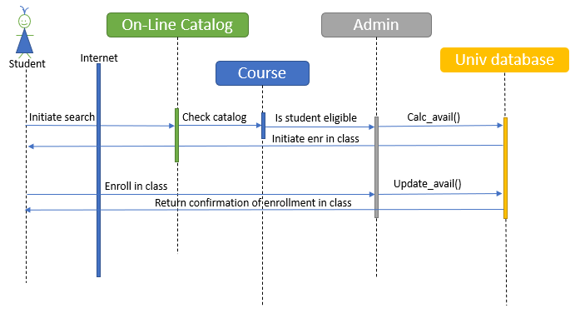
Sequence Diagram: “shows object interactions arranged in time sequence”, (Wikipedia, 2022, para.1).
UML Models

Slide 6
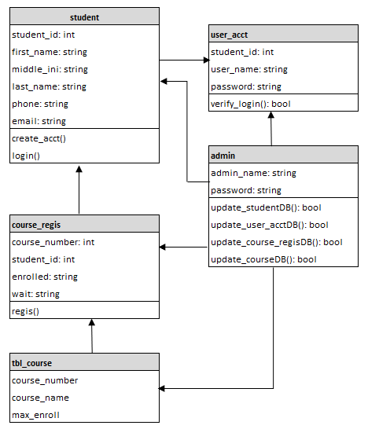
Class Diagram:
“a type of static structure diagram that describes the structure of a system by showing the system's classes, their attributes, operations (or methods), and the relationships among objects” (Wikipedia, 2022, para.1).

Slide 7
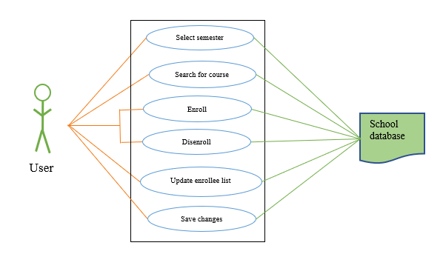
Use-Case Diagram:
“a graphical depiction of a user's possible interactions with a system” (Wikipedia, 2021, para.1).

Slide 8
Design of HTML pages
My design for the online portal was to keep it simple due to my limited skills in HTML and PHP. I am pretty fluent in SQL but that does not help with writing HTML and PHP and linking to SQL databases.
I utilized files that I had from the CST310 class and modified the code to fit this project.

Slide 9
Files: The index_499.php is the shell of the portal. The master_499.php file is the details of the ‘Student online Portal’. The login_499.php file is the page for the user to enter their login information to login. The registration_499.php file is how the data that the user enters, gets into the MySQL database. The sendData_499.php file contains the arrays needed to connect to the database.

Slide 10
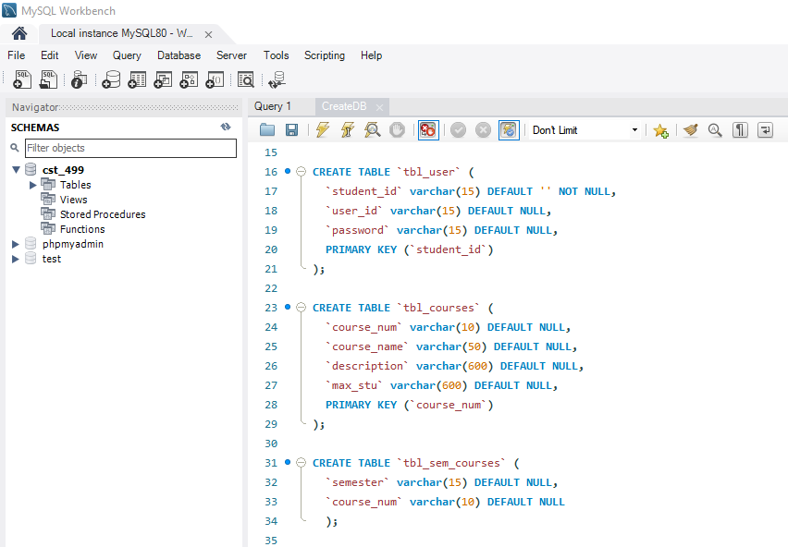
Screen shot of MySQL Workbench showing query to create table in database
This is how I created my user table in the database

Slide 11
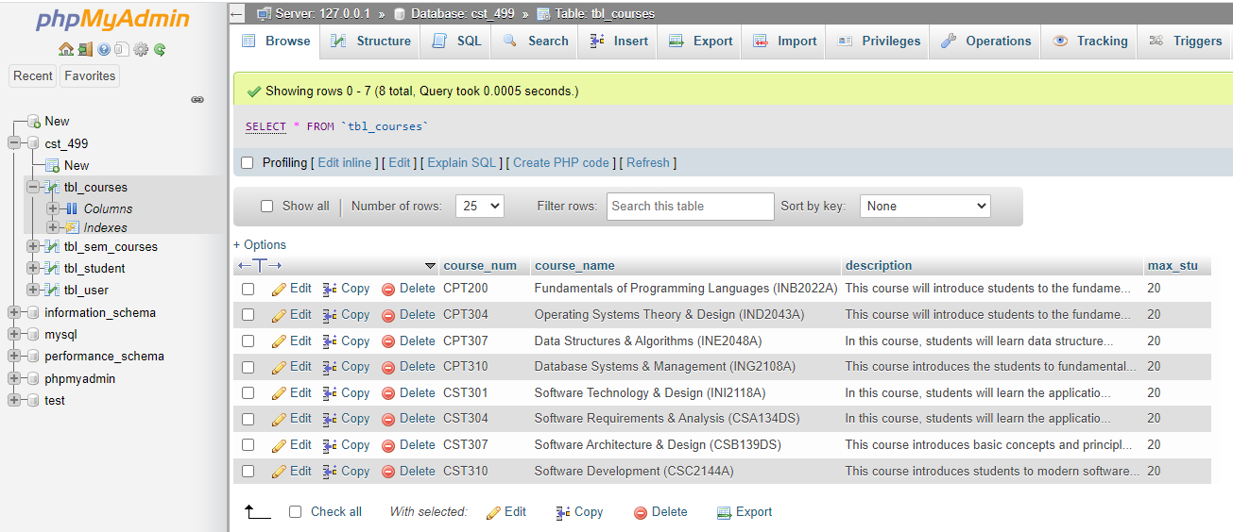
Screen shot after running the query to add data to the tbl_courses table.

Slide 12
References
Class diagram. (2022, April 16). In Wikipedia. Class diagram - Wikipedia
Sequence diagram. (2022, March 22). In Wikipedia. Sequence diagram - Wikipedia
Use case diagram. (2021, October 30). In Wikipedia. Use case diagram – Wikipedia

Slide 13

Thank You!
Becky

